Slide 1
CHAPTER 05
Data Definition Language (DDL)
Slide 6- <number>

Slide 2
Basic SQL
SQL language
  Considered one of the major reasons for the commercial success of relational databases
SQL
  The origin of SQL is relational predicate calculus called tuple calculus.
  SQL Actually comes from the word “SEQUEL” which was the original term used in the paper: “SEQUEL TO SQUARE” by Chamberlin and Boyce. Now popularly known as “Structured Query language”.
  SQL is a practical rendering of the relational data model with syntax
Slide 6- 4

Slide 3
SQL Data Definition, Data Types, Standards
Terminology:
  Table, row, and column used for relational model terms relation, tuple, and attribute
CREATE statement
  Main SQL command for data definition
The language has features for : Data definition, Data Manipulation, Transaction control (Transact-SQL, Ch. 20), Indexing (Ch.17), Security specification (Grant and Revoke- see Ch.30), Active databases (Ch.26), Distributed databases (Ch.23) etc.
Slide 6- 5

Slide 4
SQL Standards
SQL has gone through many standards: starting with SQL-86 or SQL 1. SQL-92 is referred to as SQL-2.
Later standards (from SQL-1999) are divided into core specification and specialized extensions. The extensions are implemented for different applications – such as data mining, data warehousing, etc.
In 2008 they added Object-oriented features (Ch.12).
SQL-3 is the current standard which started with SQL-1999. It is not fully implemented in any RDBMS.
Slide 6- 6

Slide 5
Schema and Catalog Concepts in SQL
We cover the basic standard SQL syntax – there are variations in existing RDBMS systems
SQL schema
  Identified by a schema name
  Includes an authorization identifier and descriptors for each element
Schema elements include
  Tables, constraints, views, domains, and other constructs
Each statement in SQL ends with a semicolon
Slide 6- <number>

Slide 6
Schema and Catalog Concepts in SQL (cont’d.)
CREATE SCHEMA statement
  CREATE SCHEMA COMPANY AUTHORIZATION ‘Jsmith’;
Catalog
  Named collection of schemas in an SQL environment
Slide 6- 8

Slide 7
The CREATE TABLE Command in SQL
Specifying a new relation
  Provide name of table
  Specify attributes, their types and initial constraints
Can optionally specify schema:
  CREATE TABLE COMPANY.EMPLOYEE ...
  or
  CREATE TABLE EMPLOYEE ...
Slide 6- 9

Slide 8
The CREATE TABLE Command in SQL (cont’d.)
Base tables (base relations)
  Relation and its tuples are actually created and stored as a file by the DBMS
Virtual relations (views)
  Created through the CREATE VIEW statement. Do not correspond to any physical file.
Slide 6- 10

Slide 9
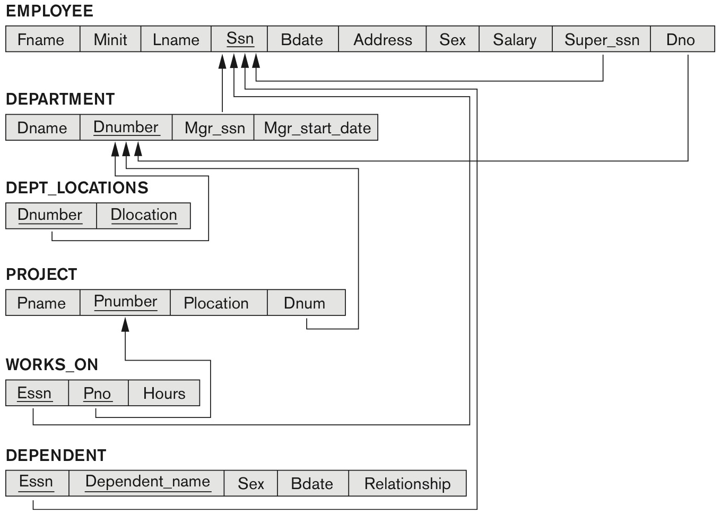
COMPANY relational database schema (Fig. 5.7)
Slide 6- 11

Slide 10
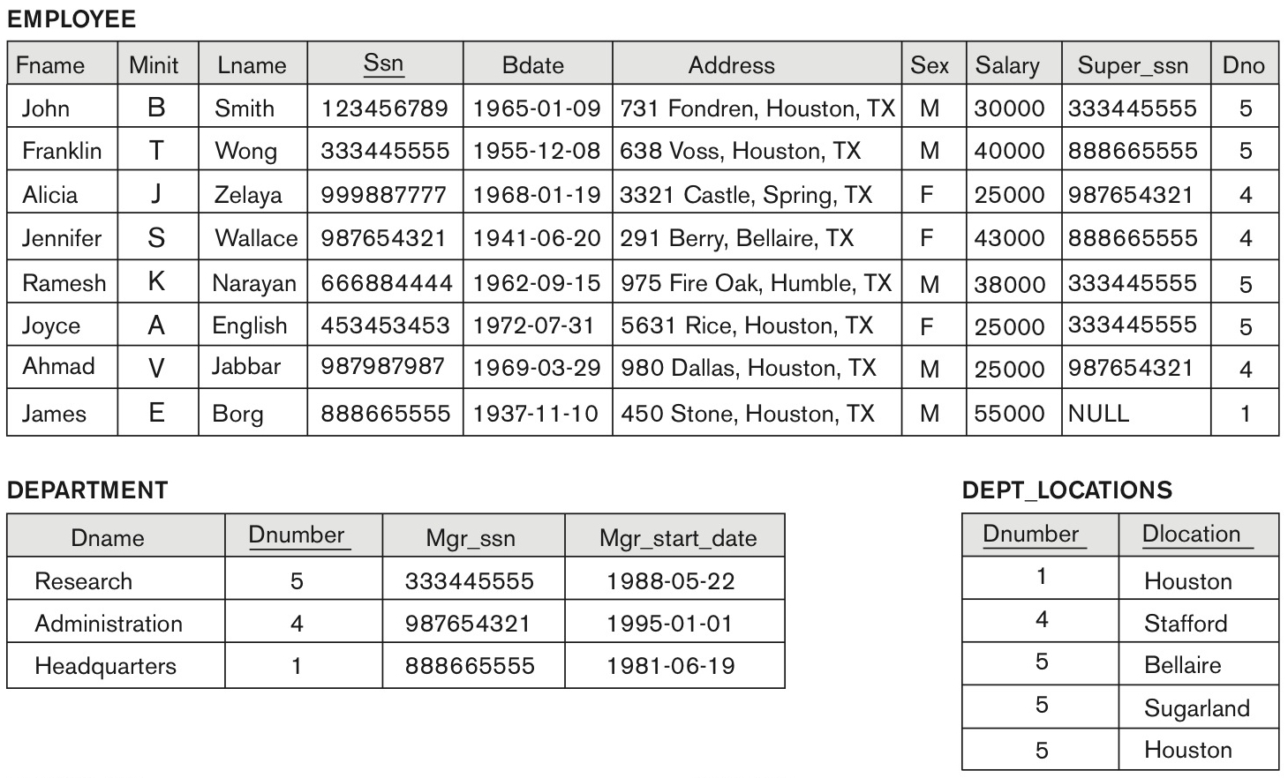
One possible database state for the COMPANY relational database schema (Fig. 5.6)
Slide 6- 12

Slide 11
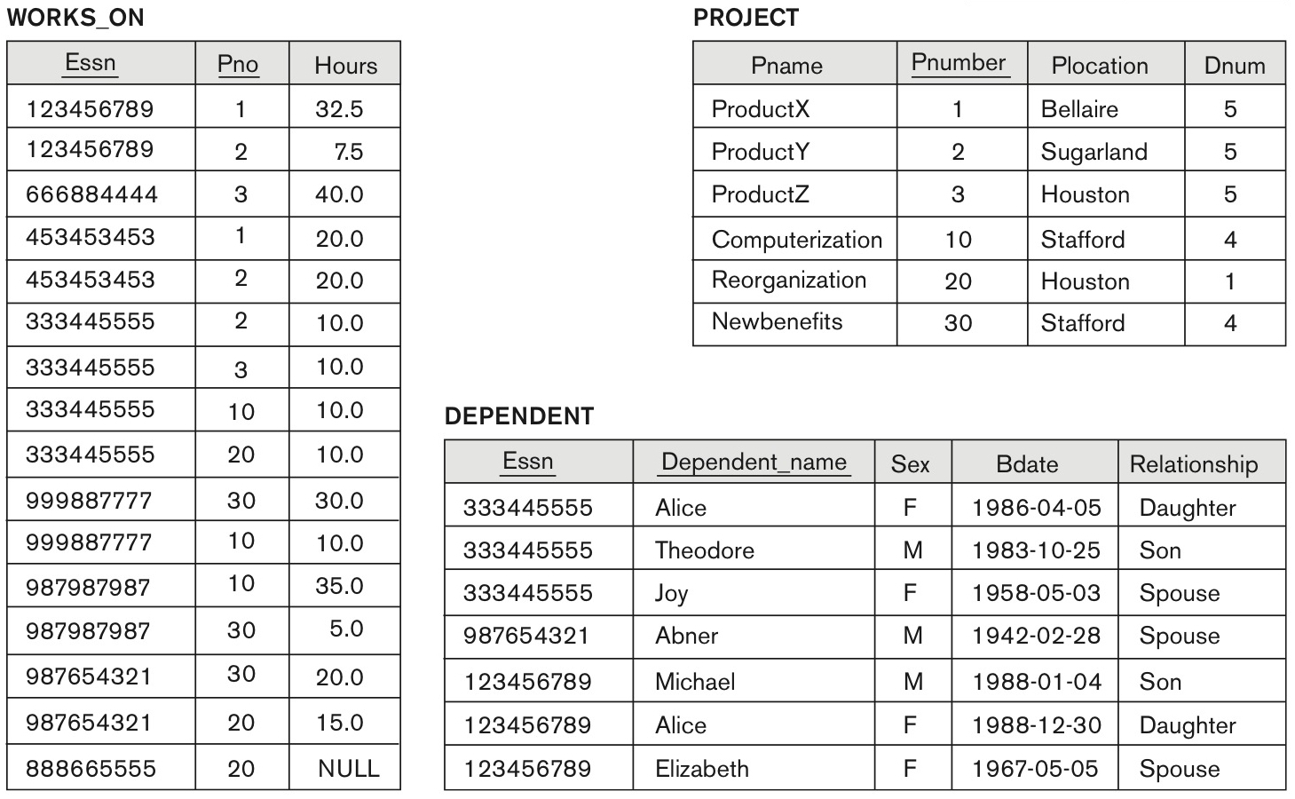
One possible database state for the COMPANY relational database schema – continued (Fig. 5.6)
Slide 6- 13

Slide 12
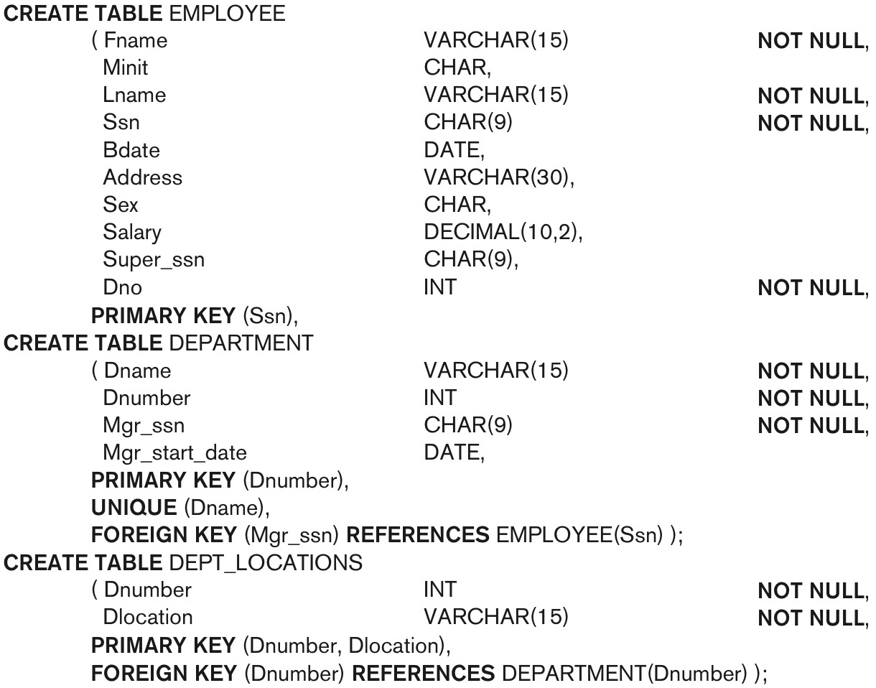
SQL CREATE TABLE data definition statements for defining the COMPANY schema from Figure 5.7 (Fig. 6.1)
continued on next slide
Slide 6- 14

Slide 13
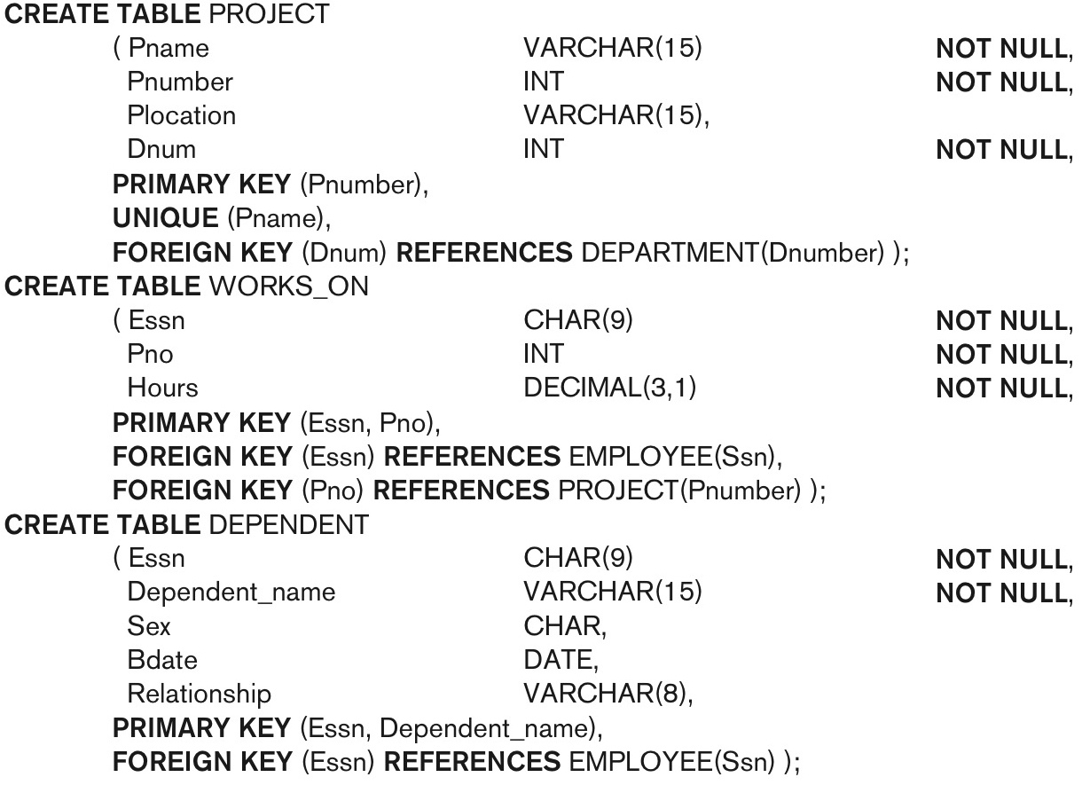
SQL CREATE TABLE data definition statements for defining the COMPANY schema from Figure 5.7 (Fig. 6.1)-continued
Slide 6- 15

Slide 14
The CREATE TABLE Command in SQL (cont’d.)
Some foreign keys may cause errors
  Specified either via:
    Circular references
    Or because they refer to a table that has not yet been created
  DBA’s have ways to stop referential integrity enforcement to get around this problem.
Slide 6- 16

Slide 15
Attribute Data Types and Domains in SQL
Basic data types
  Numeric data types
    Integer numbers: INTEGER, INT, and SMALLINT
    Floating-point (real) numbers: FLOAT or REAL, and DOUBLE PRECISION
  Character-string data types
    Fixed length: CHAR(n), CHARACTER(n)
    Varying length: VARCHAR(n), CHAR VARYING(n), CHARACTER VARYING(n)
Slide 6- 17

Slide 16
Attribute Data Types and Domains in SQL (cont’d.)
  Boolean data type
    Values of TRUE or FALSE or NULL
  DATE data type
    Ten positions
    Components are YEAR, MONTH, and DAY in the form YYYY-MM-DD
    Multiple functions available in RDBMSs to change date formats
Slide 6- 18

Slide 17
Attribute Data Types and Domains in SQL (cont’d.)
Additional data types
  Timestamp data type
  Includes the DATE and TIME fields
    Plus a minimum of six positions for decimal fractions of seconds
    Optional WITH TIME ZONE qualifier
  INTERVAL data type
    Specifies a relative value that can be used to increment or decrement an absolute value of a date, time, or timestamp
  DATE, TIME, Timestamp, INTERVAL data types can be cast or converted to string formats for comparison.
Slide 6- 19

Slide 18
Specifying Constraints in SQL
Basic constraints:
Relational Model has 3 basic constraint types that are supported in SQL:
  Key constraint: A primary key value cannot be duplicated
  Entity Integrity Constraint: A primary key value cannot be null
  Referential integrity constraints : The “foreign key “ must have a value that is already present as a primary key, or may be null.
Slide 6- <number>

Slide 19
Specifying Attribute Constraints
  Other Restrictions on attribute domains:
CHECK clause
  Dnumber INT NOT NULL CHECK (Dnumber > 0 AND Dnumber < 21);
Slide 6- 22

Slide 20
Specifying Key and Referential Integrity Constraints
PRIMARY KEY clause
  Specifies one or more attributes that make up the primary key of a relation
  Dnumber INT PRIMARY KEY;
UNIQUE clause
  Specifies alternate (secondary) keys (called CANDIDATE keys in the relational model).
  Dname VARCHAR(15) UNIQUE;
Slide 6- <number>

Slide 21
Specifying Key and Referential Integrity Constraints (cont’d.)
FOREIGN KEY clause
  Default operation: reject update on violation
  Attach referential triggered action clause
    Options include SET NULL, CASCADE, and SET DEFAULT
Slide 6- <number>

Slide 22
Giving Names to Constraints
Using the Keyword CONSTRAINT
  Name a constraint
  Useful for later altering
Slide 6- <number>

Slide 23
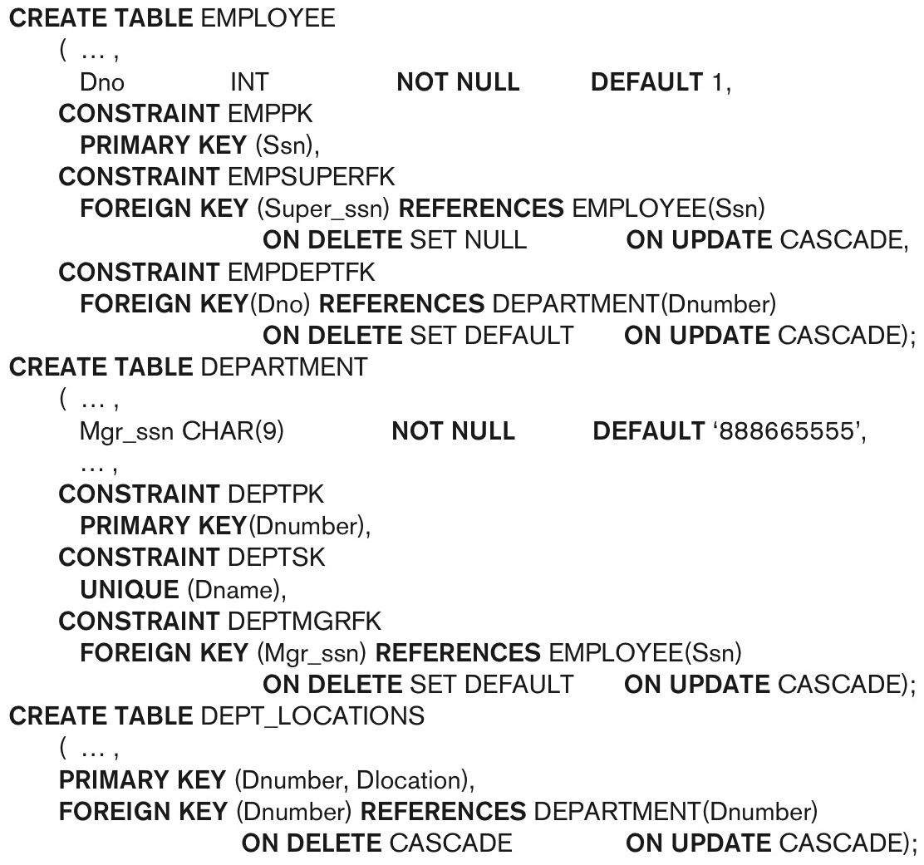
Default attribute values and referential integrity triggered action specification (Fig. 6.2)
Slide 6- <number>

Slide 24
Specifying Constraints on Tuples Using CHECK
  Additional Constraints on individual tuples within a relation are also possible using CHECK
CHECK clauses at the end of a CREATE TABLE statement
  Apply to each tuple individually
  CHECK (Dept_create_date <= Mgr_start_date);
Slide 6- <number>

